Slide 1
Morocco 1st Crisis – March1905 2nd Crisis – July 1911
Morocco was the scene of two diplomatic crises in the years before World War I, one in 1905-1906 and the other in 1911. Both of the crises ended peacefully, although tensions did temporarily rise. The crises brought the British and French governments, two traditional rivals, closer together. They also left the German government unhappy with the results.
Notes:
Main info bud for 1st Moroccan Crisis – each crisis will have it’s own main bud with supporting dots.

Slide 2
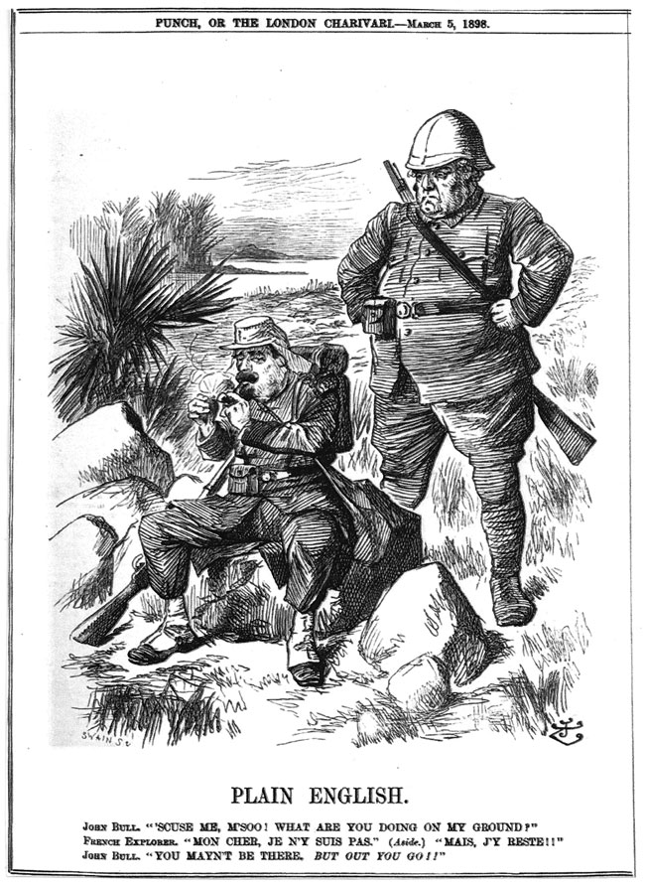
Fashoda
In 1898, following a clash in what is today the Sudan, the British and French came to a deal. Britain received French recognition of its control over the Sudan and in exchange pledged to support French control over Morocco. The Germans were not a part of the agreement and thus did not recognize it.
http://mideastcartoonhistory.com/Prologue/fashodaIncident_01.jpg

Slide 3
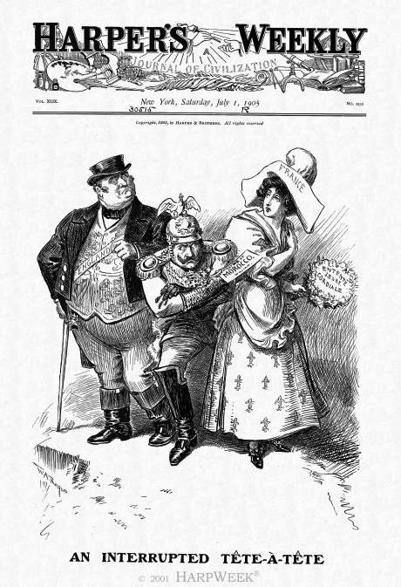
First Morocco Crisis
Germany’s Kaiser Wilhelm provoked the crisis by visiting Morocco and promising its Sultan his support against French imperialism. He sought to drive a wedge between the British and French, get beneficial trade terms from the Sultan, and maybe acquire a German naval base on the Moroccan coast.
http://www.harpweek.com/Images/SourceImages/CartoonOfTheDay/July/070105m.jpg

Slide 4
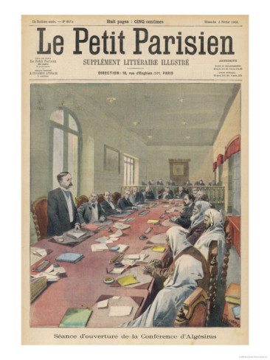
The Algeciras Conference
The 1906 conference produced an agreement that limited French control over Morocco and promised all of the great powers equal economic access to Morocco. Germany agreed not to build a naval base there.
http://imgc.allpostersimages.com/images/P-473-488-90/17/1743/92W3D00Z/posters/the-conference-of-algeciras.jpg

Slide 5
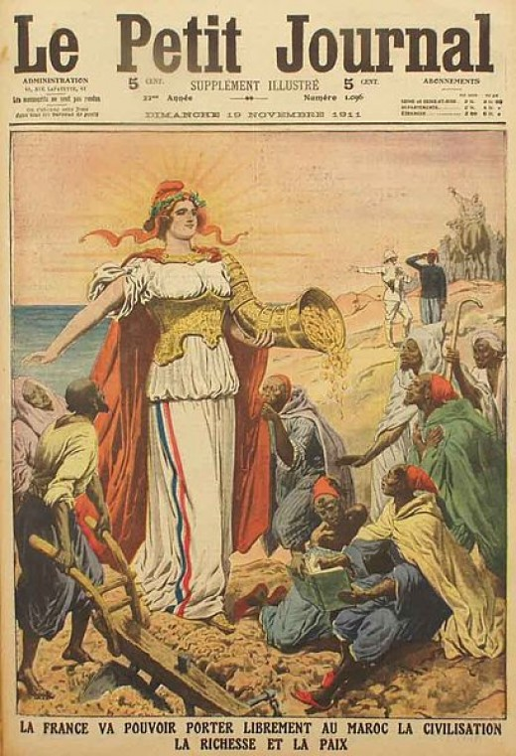
Second Morocco Crisis
The second crisis began in 1911 after the French Army used too much force in putting down strikes in Moroccan cities. The Germans again rose to Morocco’s defense and argued that France violated the Algeciras agreement by sending in troops. French nationalists argued that they were bringing civilization to the Moroccans and that Germany had no business interfering.
http://s2.hubimg.com/u/6833197_f520.jpg
Notes:
Begin new info dot here – main bud for second crisis – July, 1911

Slide 6
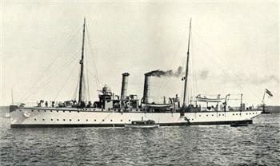
The Panther
Germany dispatched the lightly-armed ship Panther to Morocco to support the Sultan. Although it was a small and inoffensive ship, many people in France and England thought it was an unnecessary German provocation. Still, neither country thought it important enough to send their own ships to Morocco in response.
http://www.xtimeline.com/__UserPic_Large/73125/evt100924082900111.jpg
Notes:
July 1911 – German Gunboat

Slide 7
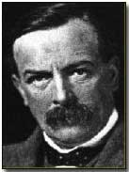
The Mansion House Speech
British politician (and future prime minister) David Lloyd George gave a key speech during the crisis that seemed to show Britain’s willingness to stand up to Germany. British support for France meant that the Kaiser would not be able to split the British and the French as he had hoped. It also showed that the great powers needed to resolve the crisis before it got out of hand.
http://www.firstworldwar.com/bio/graphics/lloydgeorge2.jpg

Slide 8
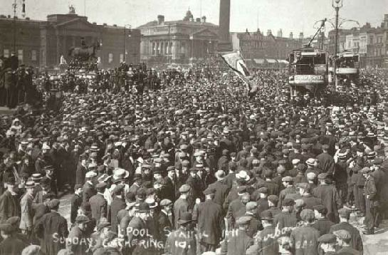
Popular Responses
Few people in Germany, France, or Britain wanted war over Morocco. Socialists in Germany and France worked together to prevent their governments from taking any military action. Workers, like these men in Liverpool, went on strike to show their opposition to war. Workers in France and Germany did the same.
http://libcom.org/files/images/history/redsunday2.jpg

Slide 9
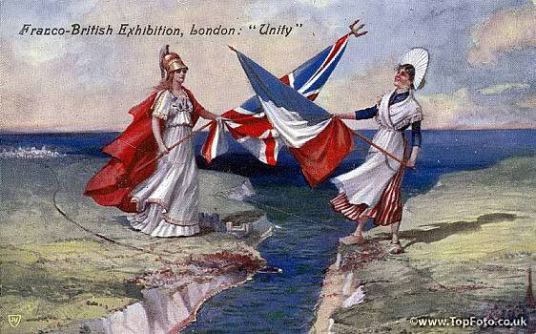
The End of the Crisis
The great powers met once again to resolve the dispute over Morocco peacefully. They agreed to uphold the principles of the Algeciras agreement. The French also gave Germany part of French Congo in exchange for a part of German Togoland to settle imperial issues in other parts of Africa. Kaiser Wilhelm dined at the French embassy in Berlin after the agreement was signed to show that the crisis was over.
http://i882.photobucket.com/albums/ac28/Thomasinecode/EntenteCordiale.jpg

Slide 10
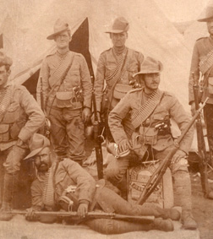
Boer War
Soon after Fashoda, the British fought a war against Dutch settlers in South Africa called Boers. The British won, but their brutal treatment of the Boers was unpopular in Europe. As a result, the British looked for allies, thus ending their traditional policy of not signing alliances. They turned to France and signed an agreement called the Entente Cordiale in 1904.
http://www.warmuseum.ca/cwm/exhibitions/boer/images/South_Africa-19820205-003.jpg
Notes:
Own info dot – no supporting buds

